Slide 1
NI Switch Executive Training

Slide 2
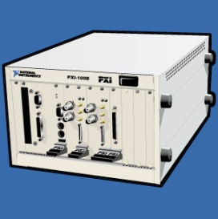
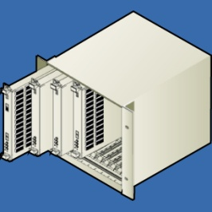

Modular Test Architecture
Test
Management
Services
Switch
Management
Software
NI
Switch
Executive
TestStand
Test Modules
Measurement Services
Unit Under
Test
Switch
Hardware
Notes:
Switch Management Software, the latest revolution in switching, fills the gap in configuring, automating, and maintaining switching systems that has frustrated many test engineers for years. Switch management software, such as NI Switch Executive, delivers the crucial software integration between the switch hardware and the actual electronic tests by providing openness and flexibility for configuring and managing switch systems using any interchangeable virtual instrument (IVI) based switch hardware available from a wide variety of switch vendors. Ultimately, switch management software allows you to spend less time implementing and programming tedious switching systems and more time exploring ways to improve test procedures and products.

Slide 3
Key Benefits to Switch Management SW
Abstraction of low-level switch programming details
Reuse and easily maintain test modules
Create test modules with generic switching calls (ex. connect “TestUUT1”)
For new tests, reuse existing modules and create new NISE configuration
Multimodule integration
Create a virtual switch device integrating multiple switches
NISE API treats virtual device as a single switch
Automatic routing
Assists in creating routes across one or several switch modules
Notes:
Switching plays a vital role in reducing the overall cost of automated test systems. Switching is also a very important factor in determining the scalability of your test systems. Building scalable switching solutions can save you a tremendous amount of time and money in responding to the increasing connectivity challenges of converging functionality. Most switch systems today involve multiple switch devices and custom switch system topologies. This session discusses the core software and hardware components recommended to build scalable switching solutions.

Slide 4
Previous Switch Config and Programming
Difficult to program
High maintenance costs
Previous Methods of Switch Configuration
None
Spreadsheet based
*.txt or *.ini based
Rough in-house utility
Notes:
As can be imagined, designing, implementing, and deploying sophisticated switch systems can be a very difficult and time-consuming task for most test engineers. There are many factors that must be taken into consideration such as the types of electronic signals, available routes for connections, necessary hardwires for physically linking multiple switch devices to expand the multiplexer or matrix devices, as well as the cumbersome programming tasks remaining once all of the connections have been laid out. In most cases, the signal types connected in test systems require a variety of switch hardware based upon different bus architectures and vendors ranging from PXI, SCXI, VXI, and GPIB. As a result, many test engineers have invested time in creating in-house tools or spreadsheet-based methods that they use to make their lives easier by providing a more effective way to implement and manage their switching needs. However, since these tools were often developed in the limited amounts of spare time, they aid in getting the job done but do not provide the best solution for configuring and maintaining switch systems.

Slide 5
NI Switch Executive
Accessed via MAX
Operates as a configuration utility
Built on top of the IVI switch class driver
Provides a bridge between the driver level and the ADE level
Is integrated with LabVIEW, LabWindows/CVI, C/C++, Visual Basic and TestStand
Provides support functions within these environments to utilize Virtual Devices created within NISE
Easily deployable to other systems
Includes hardware protection features
Notes:
Switch Executive is NI’s answer to the switching problem. It provides switch management functions integrated with NI development environment software and can handle even the most complicated switching schemes with ease.

Slide 6
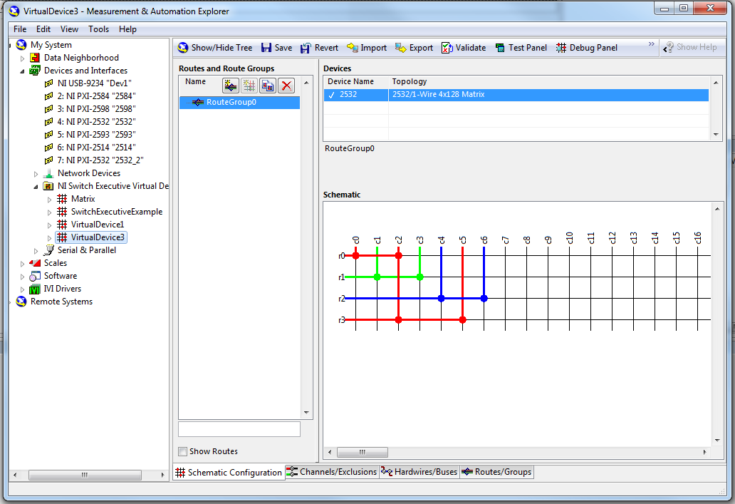
System Level Switch Management Software
NI Switch Executive
Visual Route Editor
Supports common and custom topologies
Multi-module configuration
End-to-end routing
System validation
Automated configuration export and system documentation
Notes:
NI Switch Executive system level management software greatly reduces the switch software development time in sophisticated switching applications. Specifically, NI Switch Executive features an easy-to-use, interactive Visual Route Editor environment to configure your complete switch system without writing a single line of code. NI Switch Executive supports common and custom topologies and easily integrates multiple switch modules into a single “virtual switch device”. You can also take advantage of the end-to-end routing features in NI Switch Executive to quickly define routes by simply selecting the two endpoints to connect and NI Switch Executive will identify an available path. The entire switch system can be validated in simulation or runtime mode during any point in the development process to detect unexpected configuration issues which might delay development and deployment. All NI Switch Executive switch system configurations can be exported to an NCE, XLS, XLSX, TXT, or XML file for rapid deployment and easily automated through high-level API calls.

Slide 7
Supports NI and 3rd Party Switch Hardware
Built on top of the IVI Switch Class Driver
Integrates ANY IVI compliant switch
IVI Driver development assistance available through NI
Notes:
NI Switch Executive is built on top of the IVI switch class driver and works with any IVI-compliant switch driver. All National Instruments switch modules include NI-SWITCH, a full-featured IVI-compliant driver. In addition to National Instruments PXI and SCXI switch modules, you can also control many third-party PXI, VXI, and GPIB modules.
Since NI Switch Executive leverages the benefits of the Interchangeable Virtual Instruments (IVI) standard, you can quickly interchange your IVI compliant switch hardware with another version of the switch or a switch from a different vendor.

Slide 8
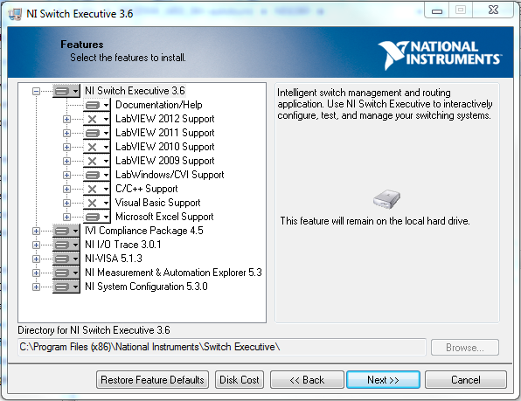
NISE Installed Components
NISE Help Files and Documentation
Support for the following ADEs
LabVIEW
TestStand
LabWindows/CVI
C++
Visual Basic
Microsoft Excel
Support Products
IVI Compliance
NI I/O Trace
NI-VISA
MAX
NI System Configuration
Notes:
NISE installs MAX, IVI, and NI-VISA on the computer if it is not already installed, as well as support for LabVIEW, LabWindows/CVI, Visual Basic, and C++ if any of these development environments are installed. As well as installing support software, Switch Executive installs help files and documentation that provide valuable information about how NISE functions and how best to utilize its tools.
The following slides show this being demonstrated.

Slide 9
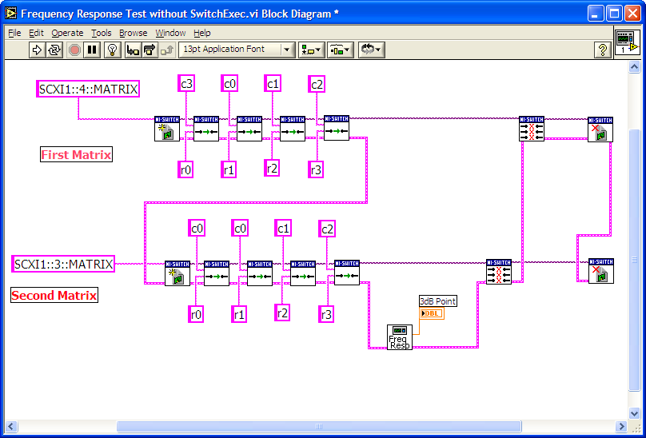
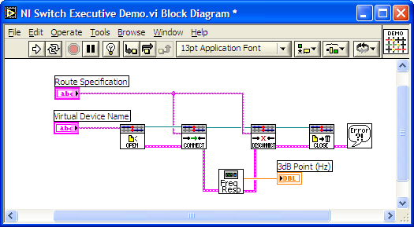
Seamless Integration With LabVIEW
BEFORE
AFTER
Notes:
NI Switch Executive also delivers seamless integration with all NI application development software tools such as LabVIEW, LabWindows/CVI, Measurement Studio for Visual Studio, and TestStand. Shown above are two LabVIEW diagrams illustrating the before and after of implementing the switch connections used in the example on the previous slide. Notice the lack of intuitiveness and difficulty in configuring and maintaining the code in the BEFORE screenshot while the AFTER screenshot illustrates the rapid application development features of the NI Switch Executive VIs in LabVIEW and the flexibility for easily modifying the switch configurations.
Discussed in previous slide.

Slide 10
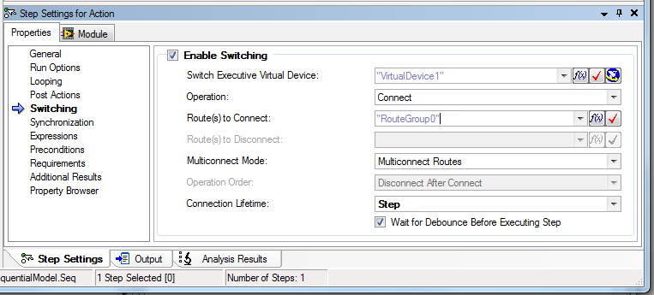
NI Switch Executive in TestStand
Seamless integration with NI TestStand
Occurs before all other items in step
Notes:
NI Switch Executive application programming interface (API) is designed for rapid system level programming and control of defined routes from LabVIEW, LabWindows/CVI, C/C++, and Visual Basic. Fully functional examples are available for automating NI Switch Executive from each of these environments.
As shown above, NI TestStand test management software also provides built-in connections to NI Switch Executive configurations to completely automate your switch operations without programming any code!
Discussed in previous slide.

Slide 11
Summary
Greatly simplify switch programming with switch management software
Multimodule integration
Automatic routings
Channel aliases, routes and route groups
Abstract low-level programming for code reuse and maintenance
Build scalable switch solutions with modular switch software
Open, modular switch platform
Multiple topology devices
System and module level switch software
Notes:
Building a scalable switch solution can be easily accomplished by using modular switch hardware and software featuring an open, modular switch platform, devices featuring multiple switch topologies, and a scalable switch software architecture consisting of system and module level switch software.

Slide 12
NI Switch Executive Walkthrough
Notes:
Follow this walkthrough if the students do not have time to do the demo on their own.

Slide 13
Creating a Virtual Device
c0
c1
c2
c3
c4
c5
c6
c7
r0
r1
r2
r3
IVI Devices
Matrix1
Notes:
To further illustrate some of the core capabilities that NI Switch Executive provides, consider a simplified example of testing a consumer electronic device. In this scenario, the we need to connect a combination of routes between the test instruments and the 4 test points on the UUT. For illustration purposes, the above figure shows an abbreviated representation of an 8x8 matrix topology provided by the user defined IVI logical switch device Aliased “SimpleMatrix1”. While this example uses a matrix switch topology, remember NI Switch Executive is also designed for use with general purpose and multiplexing topologies.

Slide 14
DEMO!

Slide 15
Creating a Virtual Device
Show AE how to create a virtual device from an IVI or NI Switch device (both would be nice)
Explain how you can have multiple NISE virtual devices for a single hardware (allowing multiple tests to be developed for multiple DUTs, on the same hardware)
Video: http://www.screencast.com/t/Z9gZIVMdFX

Slide 16
Multiple Devices in a Virtual Device
c0
c1
c2
c3
c4
c5
c6
c7
c0
c1
c2
c3
c4
c5
c6
c7
r0
r1
r2
r3
IVI Devices
Matrix1
Matrix2
Notes:
A key requirement of automated test systems designed to overcome the increasing testing challenges is the ability to easily scale the system up or down. A perfect example of this is illustrated above when you may be required to add an additional test fixture to implement parallel testing and you need to add extra switch hardware to your test system.

Slide 17
DEMO!

Slide 18
Upgrading a Virtual Device
Show AE how to upgrade a virtual device by adding in another module. (show them how to delete this module as well)
Explain how you can have a NISE virtual device reference multiple hardware devices to create large matrices.
Video:
http://www.screencast.com/t/FOwyfzkgf

Slide 19
Channel Alias’
DC_Power
UUT2_Vcc
UUT2_Out2
UUT_Vcc
UUT_Out2
UUT2_Out
UUT_Out
UUT2_In
Source
UUT_In
DMM
Scope
c0
c1
c2
c3
c4
c5
c6
c7
c0
c1
c2
c3
c4
c5
c6
c7
r0
r1
r2
r3
IVI Devices
Matrix1
Aliased Channels
Notes:
NI Switch Executive’s rapid configuration environment includes tools for configuring the channels used in complex switching systems. For instance, given the example above, you could quickly create alias names and add unique comments for each channel; greatly simplifying the management of hundreds or thousands of switch channels in sophisticated switch systems since you can refer to a channel as "DMM" or "Scope" instead of "c0" or "c2". This can be extremely useful for systems with multiple switch devices since it is common with these systems to encounter multiple channels among the switch devices with the same name, such as "c0" or "c2” found in multiple switch devices representing completely different inputs or outputs. With NI Switch Executive, a test engineer can assign unique names to these channels so they become easier to recognize and use in the test programs as shown above.

Slide 20
DEMO!

Slide 21
Adding Alias to a Virtual Device
Show AE how to create channel alias’ (from the channels tab, and from the schematic tab)
Explain how this makes managing switches much easier.
Video:
http://www.screencast.com/t/CKMbkOZ0

Slide 22
Hardwires
DC_Power
UUT2_Vcc
UUT2_Out2
UUT_Vcc
UUT_Out2
UUT2_Out
UUT_Out
UUT2_In
Source
UUT_In
DMM
Scope
c0
c1
c2
c3
c4
c5
c6
c7
c0
c1
c2
c3
c4
c5
c6
c7
r0
r1
r2
r3
IVI Devices
Matrix1
Matrix2
Aliased Channels
Hardwires
Notes:
NI Switch Executive allows you to add or remove switch hardware from new or existing virtual switch configurations at any time without affecting your test programs. It also allows you to easily define how you are physically linking the multiple switch devices so that the intelligent NI Switch Executive Routing Engine can provide assisted end-to-end routing across multiple switch devices.

Slide 23
DEMO!

Slide 24
Adding Hardwires to a Virtual Device
Show AE how to create channel hardwires (from the channels tab, and from the schematic tab)
Explain how this tells the software that pins are physically connected in the system.
Show how to make a bus (a collection of hardwires)
Video:
http://www.screencast.com/t/BodkeJzAc

Slide 25
Routes
DC_Power
UUT2_Vcc
UUT2_Out2
UUT_Vcc
UUT_Out2
UUT2_Out
UUT_Out
UUT2_In
Source
UUT_In
DMM
Scope
c0
c1
c2
c3
c4
c5
c6
c7
c0
c1
c2
c3
c4
c5
c6
c7
r0
r1
r2
r3
IVI Devices
Matrix1
Routes
PowerUUT
Matrix2
Aliased Channels
Hardwires
Notes:
Once you have quickly configured all of the necessary channels, NI Switch Executive provides assisted end-to-end routing capabilities to assist in connecting channels together to form routes. With this feature, you can simply select two channels from the list of aliases and/or channel names and NI Switch Executive automatically recommends a route based upon your specified channel, hardwire, and signal characteristics. The suggested route is then displayed graphically, including any physical hardwires that are crossed between multiple switch devices in the system. The figure above illustrates the suggested route to connect the “DCPower” and “UUT_Vcc” channels together. Given the suggested route you can either accept the suggested route, choose from other available routes, or manually specify the route. Once you have identified the appropriate route, you can also assign an alias route name such as “PowerUUT” to simplify your switch configuration with a more intuitive name representing the connection between the test channels.

Slide 26
DEMO!

Slide 27
Adding routes to a Virtual Device
Show AE how to create routes (from the channels tab, and from the schematic tab)
Talk about reserved for routing and how if you set a route (c0->c13) it will ask you to set rows as reserved for routing and will automatically choose the next available row in order to complete the connection between these columns.
Video:
http://www.screencast.com/t/GclBpxhSix

Slide 28
Route Groups
DC_Power
UUT2_Vcc
UUT2_Out2
UUT_Vcc
UUT_Out2
UUT2_Out
UUT_Out
UUT2_In
Source
UUT_In
DMM
Scope
c0
c1
c2
c3
c4
c5
c6
c7
c0
c1
c2
c3
c4
c5
c6
c7
r0
r1
r2
r3
IVI Devices
Matrix1
Routes
PowerUUT
Matrix2
MeasSourceVoltage
Aliased Channels
SourceToInput
Hardwires
ScopeToOutput
Notes:
The remaining routes required for testing the electronic device are easily created in the same fashion using the convenient visual assisted end-to-end routing features. The user can name the routes to signify specific connections that should be made.

Slide 29
Route Groups
UUT2_Vcc
UUT2_Out2
UUT_Out2
UUT2_Out
DCPower
UUT_Out
UUT_Vcc
UUT2_In
Source
UUT_In
DMM
Scope
c0
c1
c2
c3
c4
c5
c6
c7
c0
c1
c2
c3
c4
c5
c6
c7
r0
r1
r2
r3
IVI Devices
Matrix1
Routes
PowerUUT
Route Groups
FreqRespTest1
Matrix2
MeasSourceVoltage
Aliased Channels
SourceToInput
Hardwires
ScopeToOutput
Notes:
Since each test performed on a UUT often requires multiple routes to be connected before the test can be performed, you can conveniently group multiple routes together to form a route group that can also be assigned an alias name. An example route group alias name based on the test example might be “FreqRespTest1” which includes the four routes: PowerUUT, MeasSourceVoltage, ScopeToInput, and ScopeToOutput. After selecting and naming the routes and route groups, the individual alias route and route group names can be used directly in your test step in the test management software or in your test programs when programming the automated switching. Thus the user can simply specify the route group alias “FreqRespTest1” within your TestStand step or make one call in their test program to connect “FreqRespTest1”, after which, NI Switch Executive will automatically connect the four routes assigned to that route group.

Slide 30
DEMO!

Slide 31
Adding Hardwires to a Virtual Device
Show AE how to create routegroups (from the channels tab, and from the schematic tab) [show drag and drop] Show how to create routegroups that contain other routegroups
Explain how this increases test time, by managing the number of connections to be made in a single call
Video (same as routes):
http://www.screencast.com/t/GclBpxhSix

Slide 32

Exclusions
DC_Power
UUT2_Vcc
UUT2_Out2
UUT_Vcc
UUT_Out2
UUT2_Out
UUT_Out
UUT2_In
Source
UUT_In
DMM
Scope
c0
c1
c2
c3
c4
c5
c6
c7
c0
c1
c2
c3
c4
c5
c6
c7
r0
r1
r2
r3
Notes:
An exclusion is a user-defined connection rule. The NISE routing engine prevents the connection of excluded channel. Exclusions are a software protection mechanism used to avoid connecting two signals together that should not be connected. For example, if you have power supplies driving two channels on a switch, you can create an exclusion for the channels. This action helps prevent accidental connection of the two signals together.
There are two types of exclusions, mutual and set exclusions. Mutual Exclusions contain a list of channels that should never connect to one another. Set exclusions contain two lists of channels, where channels from the first list should never connect to channels of the second list.

Slide 33
DEMO!

Slide 34
Adding Exclusions to a Virtual Device
Show AE how to create exclusions
Explain how this can prevent unwanted connections
Video:
http://www.screencast.com/t/qFUFodzCV

Slide 35
Deployment
NISE can export the configured files and NISE virtual devices to various file formats
.nce, .xml, .xls, .xlsx, .txt (NISE 3.6)
.xml, .xls, .xlsx, .txt (NISE 3.5 and lower)
These files are used to deploy a NISE configuration to other systems, and can be imported into a new system.
NISE 3.6 and later have the ability to export to older versions of configuration files.

Slide 36
DEMO!

Slide 37
Deployment
Export
Video:
http://www.screencast.com/t/8ly9D6OLih83
Modifying Things in Excel
Video:
http://www.screencast.com/t/FOwyfzkgf
Import
Video:
http://www.screencast.com/t/vxhxQ79R

Slide 38
EXERCISE 1
Objective:
Create the following Matrix Solution Using NISE & two simulated PXI 2501’s
Open the NISE virtual device and close the route group in LabVIEW.
DCPower
UUT_Vcc
Source
UUT_In
DMM
Scope
c0
c1
c2
c3
c4
c5
c0
c1
c2
c3
c4
c5
r0
r1
r2
r3
Notes:
Exercise Instructions:
Simulate two PXI 2501’s
Create NISE Virtual Device
Configure the PXI 2501’s into 2-Wire 4x6 Matrix
Configure button in NISE “Create New Wizard”
Add the two PXI 2501’s to the virtual device
Give the NISE Virtual Device an alias
Give aliases to the columns of one PXI 2501
Create hardwires between rows both PXI 2501’s
Create the above routes within a routegroup
Save the NISE Virtual Device
Launch Labview Example [NI Example Finder >> Toolkits and Modules >> NI Switch Executive >> NI Switch Executive – Getting Started.vi]

Slide 39
EXERCISE 2
Objective:
Create Exclusions
Export NISE configuration
Make Changes
Import NISE configuration
Notes:
Exercise Instructions:
Starting from the end of Exercise 1, create mutual exclusion between PXI 2501 #2 c0 and c1
Export the configuration as an excel file
Make 2 routes that would violate the exclusion pre created. (PXI_2051_2/c0->r0, PXI_2051_2/c1->r0) and place them in a route group
Import
Validate (notice error is thrown!)

Slide 40
Common Customer Issues
Greyed out options / can’t edit things in NISE (http://ae.natinst.com/public.nsf/web/searchinternal/43122652f3e743c886256fe70077d219?OpenDocument) (http://ae.natinst.com/public.nsf/web/searchinternal/15783c8dcc51bef7862578b500631a63?OpenDocument)
How to save NISE in other versions? (USE 3.6 to downgrade) (Various KBs ☹ http://ae.natinst.com/public.nsf/web/searchinternal/56F406007D4FB191862574710069A480)
How to use NISE
Pre-Sales: Use NISE to make life easier with switching

